Slide 1

Google Play App Market Strategy
Leveraging Tableau Dashboard Storytelling across 10,800+ Android Apps to Optimize Development, Conversion, and Revenue Models

Slide 2

Executive Diagnostics
An end-to-end Tableau data pipeline analyzing category dynamics, pricing thresholds, app size elasticity, and user rating sentiment.

Slide 3

Market Landscape Snapshot
Freemium Velocity Driven by Scale
10.8K
Tableau aggregation reveals that 92.6% of apps on Google Play are Free, accounting for over 98.4% of total download volume.
Paid upfront downloads face high user friction. Sustainable app monetization depends on freemium subscriptions, dynamic microtransactions, and ad placements.
Analyzed App Profiles

Slide 4
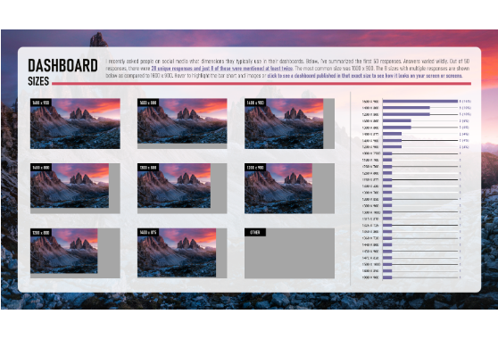
Tableau Data Architecture
Tableau Prep Cleaning: Standardized install bins (10K+ to 1B+) and converted app size strings into numerical MB metrics.
Calculated Fields: Built weighted rating scores, estimated revenue (Installs * Price), and log-scale download indexes.
Interactive Parameters: Enabled real-time filtering by category group, price tier, and minimum review volume thresholds.

Slide 5

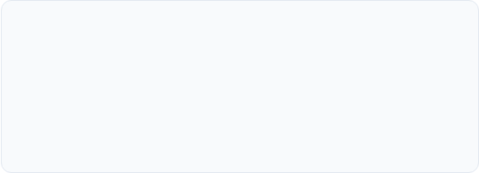
Category Opportunity Grid
1. High-Volume Red Oceans
2. High-Intent Blue Oceans
Family & Game categories represent ~35% of total app listings (~3,800 apps). High saturation means organic discovery requires steep User Acquisition (UA) ad spend.
Finance, Health & Fitness, and Productivity show exceptional install-per-app ratios. Users demonstrate stronger intent and higher lifetime value (LTV) in utility niches.

Slide 6
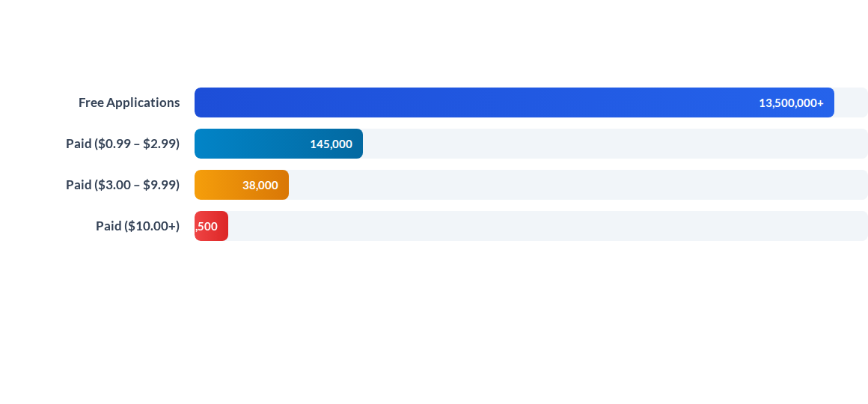
Downloads Across Price Tiers
Tableau Parameterized Chart: Free apps generate 90x more install volume than $0.99 apps. Mobile roadmap must prioritize zero-friction install funnels with in-app upgrades.

Slide 7






Core App Success Drivers
Rating Benchmark (4.2+)
Size Sensitivity (< 30MB)
Monthly Update Rhythm
Apps rated above 4.2 capture 85%+ of total store downloads. Falling below 4.0 cuts conversion rate by over 50% on search impressions.
App sizes under 30MB achieve 2.4x higher conversion in emerging markets where storage and mobile data caps remain constrained.
Apps updated at least monthly show 38% higher 90-day retention, benefiting from active algorithmic boosting in store rankings.

Slide 8
Category Performance Matrix
Category Sector | Avg App Size | Avg Rating | Monetization Model | Tableau Opportunity Score
Game | 64.3 MB | 4.28 / 5.0 | In-App Purchases (IAP) + Ads
Finance | 28.1 MB | 4.13 / 5.0 | Freemium Subscriptions
Health & Fitness | 31.5 MB | 4.25 / 5.0 | Monthly Tiered Plans
Tools & Utilities | 18.2 MB | 4.04 / 5.0 | In-App Ad Network
Family & Casual | 42.7 MB | 4.19 / 5.0 | Hybrid Ad & Micro-IAP

Slide 9
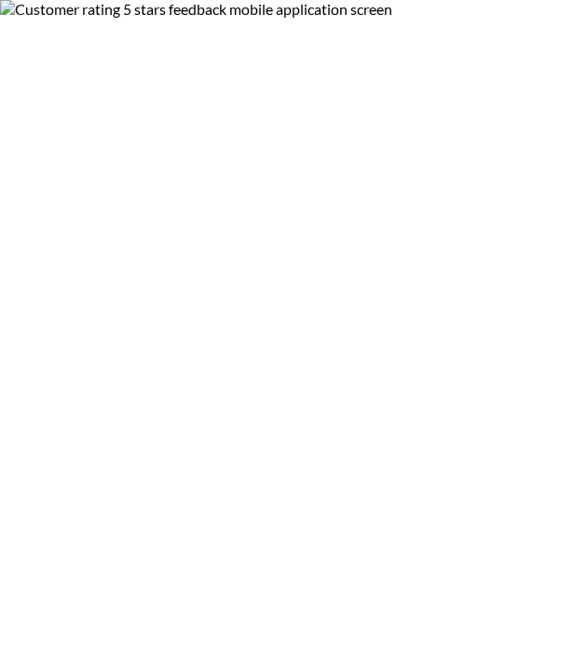
User Review Sentiment
Social Proof Acceleration
Review velocity directly dictates algorithm ranking on Google Play search. Unlocking 10,000+ positive reviews creates a self-sustaining viral acquisition loop.
Deploying smart in-app rating prompts during moments of delight (e.g., level completion) increases positive review conversion by 3x.

Slide 10
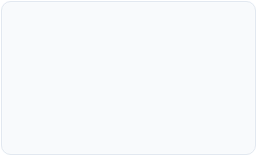
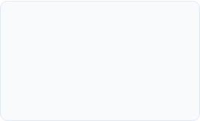

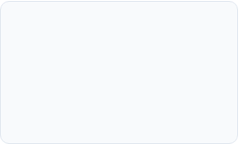
Product Growth Roadmap
Q2 - ASO & Review Prompts
Q4 - Tableau Story Monitoring
Implement smart in-app review triggers to cross the 4.2+ rating threshold.
Connect live Tableau Server dashboard to track daily LTV, CAC, and conversion.
Q1 - Lightweight Build
Q3 - Hybrid Monetization
Develop optimized APK under 30MB targeting high-intent Health/Finance niches.
Launch freemium subscription paywall alongside non-intrusive native ads.

Slide 11
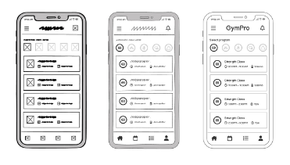
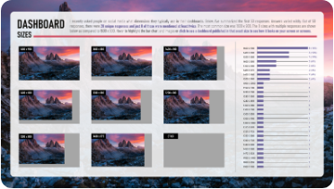

Strategic Action Pillars
Lean UX & Binary Size
Tableau Data Monitoring
Freemium Conversion
Keep binary size lean (<30MB) and streamline initial onboarding to prevent immediate uninstalls.
Establish real-time KPI alerts for rating drops, review sentiment shifts, and category trend changes.
Maximize top-of-funnel reach with free downloads while driving high LTV via tiered subscriptions.

